Slide 1
Elementary Row Operations and Linear Equations
Linear Algebra
Department of Computer Engineering
Sharif University of Technology
Hamid R. Rabiee rabiee@sharif.edu
Maryam Ramezani maryam.ramezani@sharif.edu

Slide 2
Overview
Matrix Multiplication
Elementary Row Operations
Linear Equations
Elementary Matrices

Slide 3
Matrix Multiplication

Slide 4
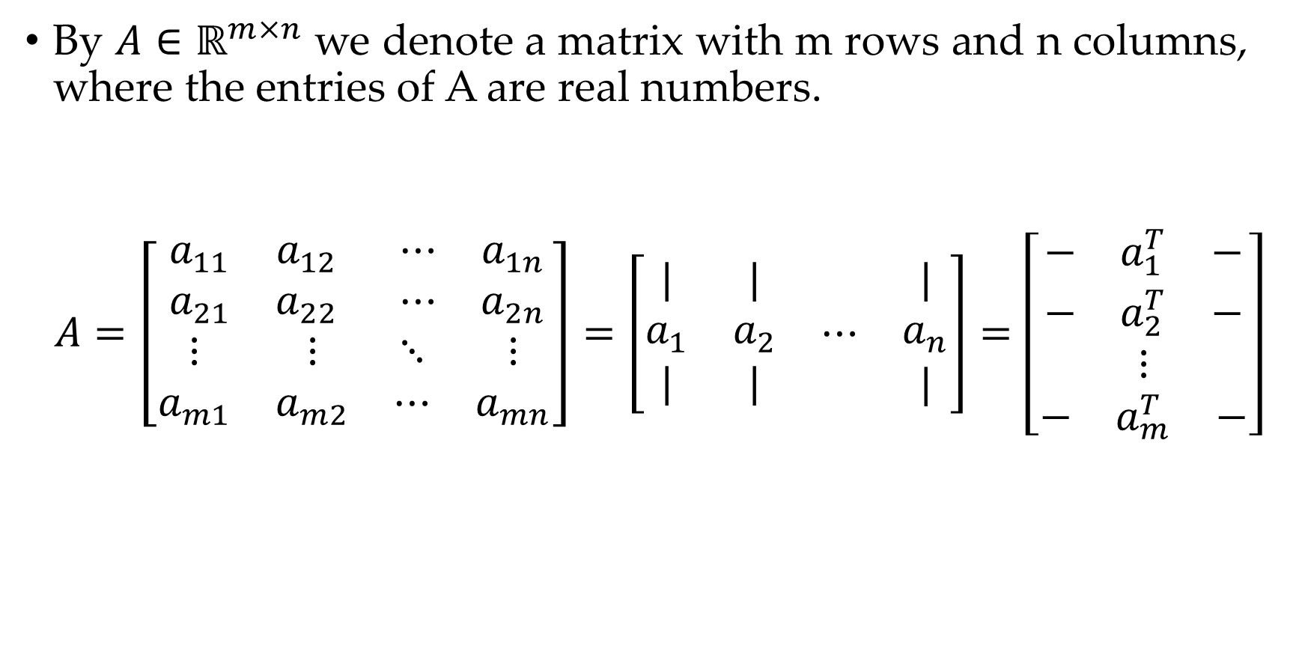
Basic Notation
By $A∈ℝ^{m×n}$ we denote a matrix with m rows and n columns, where the entries of A are real numbers.
$$A=\left[\begin{matrix}\begin{matrix}a_{11} & a_{12} \\ a_{21} & a_{22}\end{matrix} & \begin{matrix}⋯ & a_{1n} \\ ⋯ & a_{2n}\end{matrix} \\ \begin{matrix}⋮ & ⋮ \\ a_{m1} & a_{m2}\end{matrix} & \begin{matrix}⋱ & ⋮ \\ ⋯ & a_{mn}\end{matrix}\end{matrix}\right]=\left[\begin{matrix}\begin{matrix}\begin{matrix}| \\ a_{1} \\ |\end{matrix} & \begin{matrix}| \\ a_{2} \\ |\end{matrix}\end{matrix} & \begin{matrix}⋯ & \begin{matrix}| \\ a_{n} \\ |\end{matrix}\end{matrix}\end{matrix}\right]=\left[\begin{matrix}\begin{matrix}\begin{matrix}− & a_{1}^{T} & −\end{matrix} \\ \begin{matrix}− & a_{2}^{T} & −\end{matrix}\end{matrix} \\ \begin{matrix}⋮ \\ \begin{matrix}− & a_{m}^{T} & −\end{matrix}\end{matrix}\end{matrix}\right]$$

Slide 5
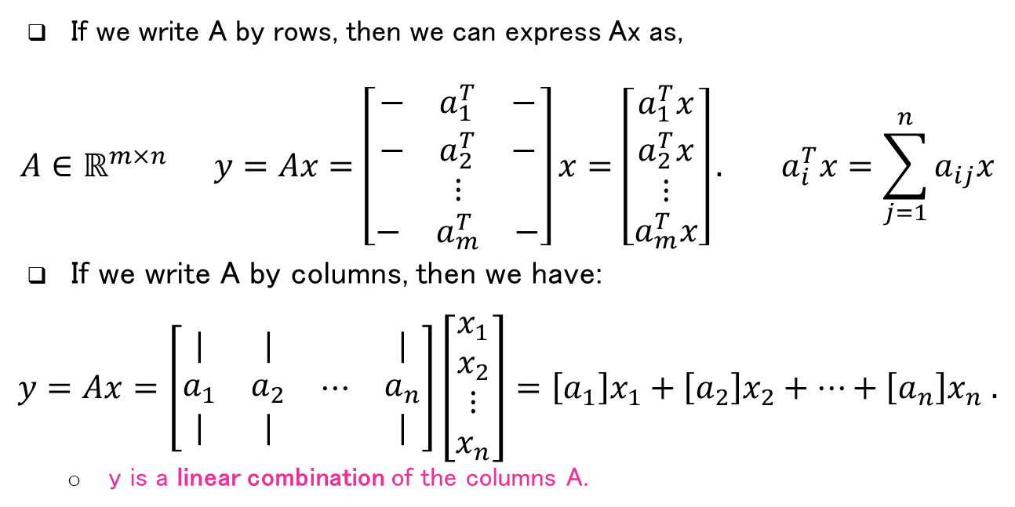
Matrix-Vector Multiplication
If we write A by rows, then we can express Ax as,
$$A∈ℝ^{m×n} y=Ax=\left[\begin{matrix}\begin{matrix}\begin{matrix}− & a_{1}^{T} & −\end{matrix} \\ \begin{matrix}− & a_{2}^{T} & −\end{matrix}\end{matrix} \\ \begin{matrix}⋮ \\ \begin{matrix}− & a_{m}^{T} & −\end{matrix}\end{matrix}\end{matrix}\right]x=\left[\begin{matrix}a_{1}^{T}x \\ a_{2}^{T}x \\ \begin{matrix}⋮ \\ a_{m}^{T}x\end{matrix}\end{matrix}\right]. a_{i}^{T}x=\sum_{j=1}^{n}{a_{ij}x}$$
If we write A by columns, then we have:
$$y=Ax=\left[\begin{matrix}\begin{matrix}\begin{matrix}| \\ a_{1} \\ |\end{matrix} & \begin{matrix}| \\ a_{2} \\ |\end{matrix}\end{matrix} & \begin{matrix}⋯ & \begin{matrix}| \\ a_{n} \\ |\end{matrix}\end{matrix}\end{matrix}\right]\left[\begin{matrix}x_{1} \\ x_{2} \\ \begin{matrix}⋮ \\ x_{n}\end{matrix}\end{matrix}\right]=\left[a_{1}\right]x_{1}+\left[a_{2}\right]x_{2}+…+\left[a_{n}\right]x_{n} .$$
y is a linear combination of the columns A.
columns of A are linearly independent if Ax = 0 implies x = 0

Slide 6
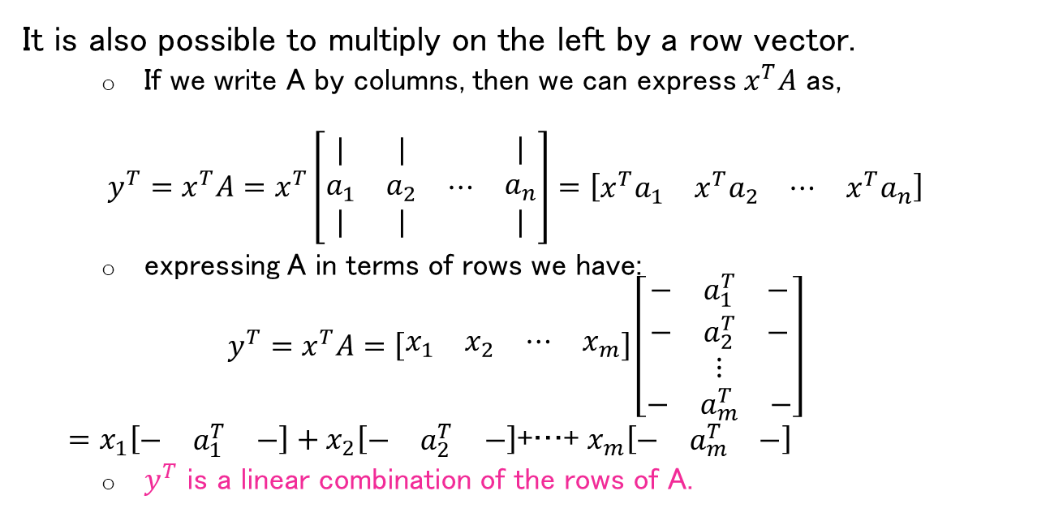
Matrix-Vector Multiplication
It is also possible to multiply on the left by a row vector.
If we write A by columns, then we can express $x^{T}A$ as,
$$y^{T}=x^{T}A=x^{T}\left[\begin{matrix}\begin{matrix}\begin{matrix}| \\ a_{1} \\ |\end{matrix} & \begin{matrix}| \\ a_{2} \\ |\end{matrix}\end{matrix} & \begin{matrix}⋯ & \begin{matrix}| \\ a_{n} \\ |\end{matrix}\end{matrix}\end{matrix}\right]=\left[\begin{matrix}\begin{matrix}{x^{T}a}_{1} & x^{T}a_{2}\end{matrix} & \begin{matrix}⋯ & {x^{T}a}_{n}\end{matrix}\end{matrix}\right]$$
expressing A in terms of rows we have:
$$y^{T}=x^{T}A=\left[\begin{matrix}\begin{matrix}x_{1} & x_{2}\end{matrix} & \begin{matrix}⋯ & x_{m}\end{matrix}\end{matrix}\right]\left[\begin{matrix}\begin{matrix}\begin{matrix}− & a_{1}^{T} & −\end{matrix} \\ \begin{matrix}− & a_{2}^{T} & −\end{matrix}\end{matrix} \\ \begin{matrix}⋮ \\ \begin{matrix}− & a_{m}^{T} & −\end{matrix}\end{matrix}\end{matrix}\right]$$ $=x_{1}\left[\begin{matrix}− & a_{1}^{T} & −\end{matrix}\right]+x_{2}\left[\begin{matrix}− & a_{2}^{T} & −\end{matrix}\right]$+…+ $x_{m}\left[\begin{matrix}− & a_{m}^{T} & −\end{matrix}\right]$
$y^{T}$ is a linear combination of the rows of A.

Slide 7
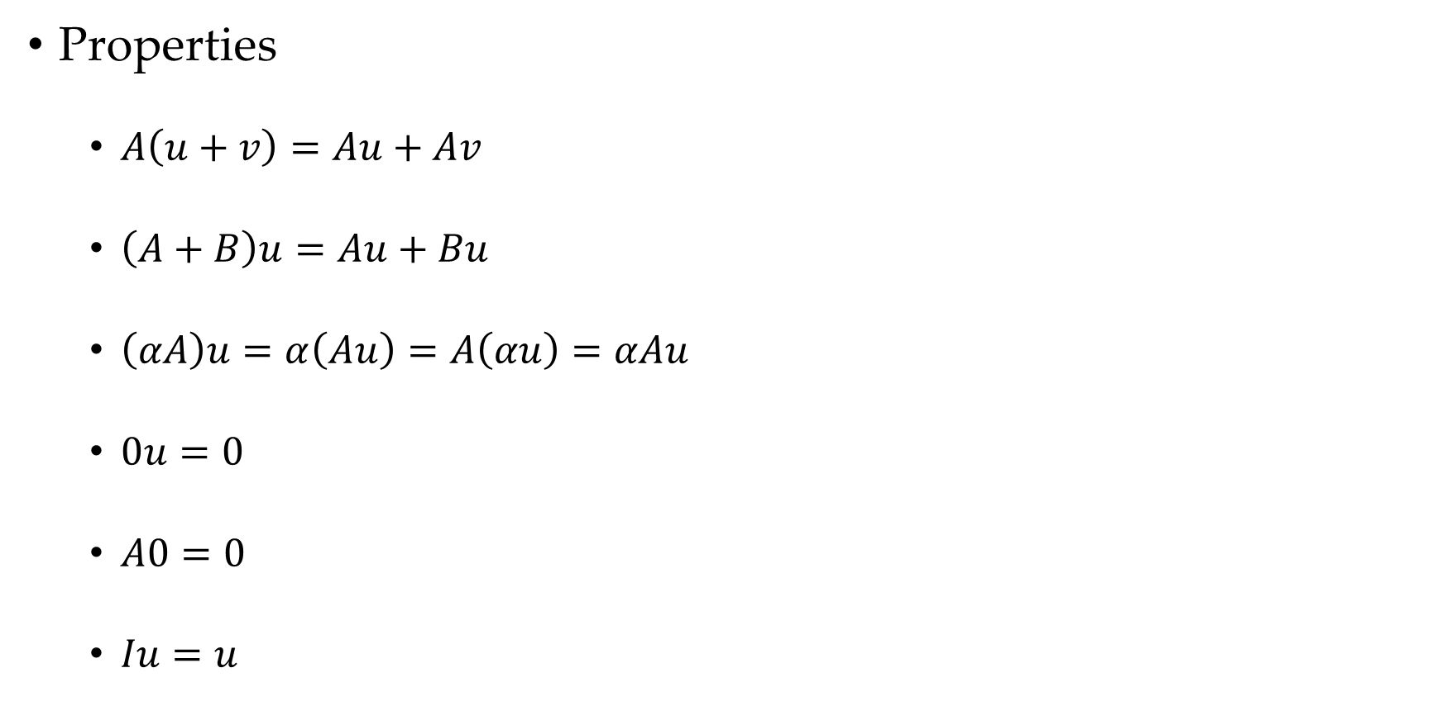
Matrix-Vector Multiplication
Properties
$A\left(u+v\right)=Au+Av$
$\left(A+B\right)u=Au+Bu$
$\left(αA\right)u=α\left(Au\right)=A\left(αu\right)=αAu$
$0u=0$
$A0=0$
$Iu=u$

Slide 8
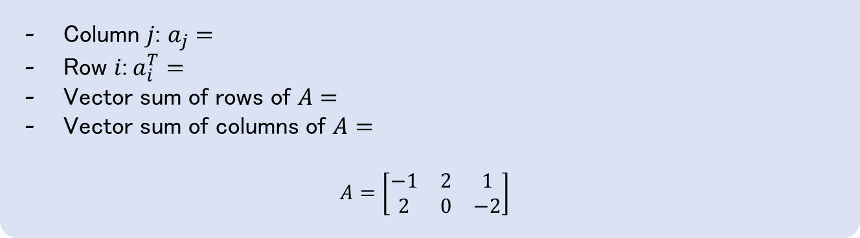
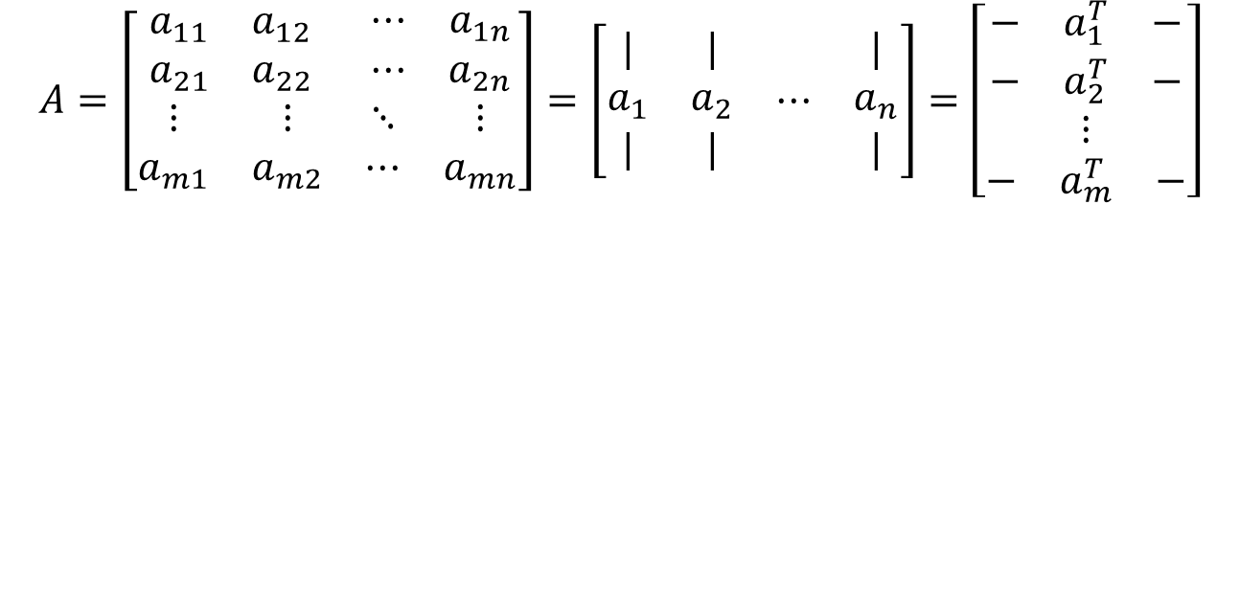
Matrix-Vector Multiplication
$$A=\left[\begin{matrix}\begin{matrix}a_{11} & a_{12} \\ a_{21} & a_{22}\end{matrix} & \begin{matrix}⋯ & a_{1n} \\ ⋯ & a_{2n}\end{matrix} \\ \begin{matrix}⋮ & ⋮ \\ a_{m1} & a_{m2}\end{matrix} & \begin{matrix}⋱ & ⋮ \\ ⋯ & a_{mn}\end{matrix}\end{matrix}\right]=\left[\begin{matrix}\begin{matrix}\begin{matrix}| \\ a_{1} \\ |\end{matrix} & \begin{matrix}| \\ a_{2} \\ |\end{matrix}\end{matrix} & \begin{matrix}⋯ & \begin{matrix}| \\ a_{n} \\ |\end{matrix}\end{matrix}\end{matrix}\right]=\left[\begin{matrix}\begin{matrix}\begin{matrix}− & a_{1}^{T} & −\end{matrix} \\ \begin{matrix}− & a_{2}^{T} & −\end{matrix}\end{matrix} \\ \begin{matrix}⋮ \\ \begin{matrix}− & a_{m}^{T} & −\end{matrix}\end{matrix}\end{matrix}\right]$$
Example: Write in matrix-vector multiplication
Column $j$: $a_{j}=$
Row $i$:$a_{i}^{T}=$
Vector sum of rows of $A=$
Vector sum of columns of $A=$
$$A=\left[\begin{matrix}−1 & 2 & 1 \\ 2 & 0 & −2\end{matrix}\right]$$

Slide 9
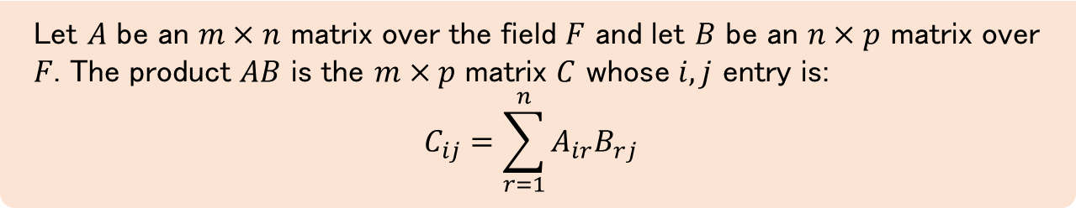
Matrix-Matrix Multiplication
Definition
Let $A$ be an $m×n$ matrix over the field $F$ and let $B$ be an $n×p$ matrix over $F$. The product $AB$ is the $m×p$ matrix $C$ whose $i,j$ entry is:
$$C_{ij}=\sum_{r=1}^{n}{A_{ir}B_{rj}}$$

Slide 10
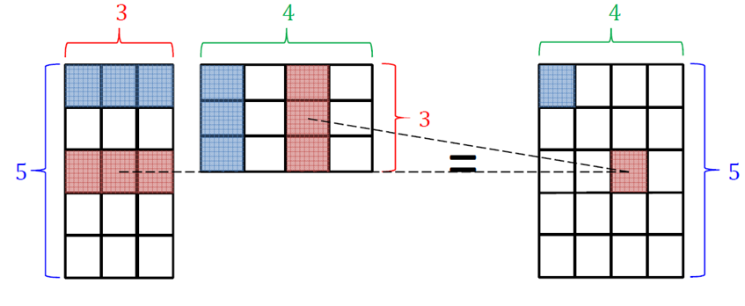
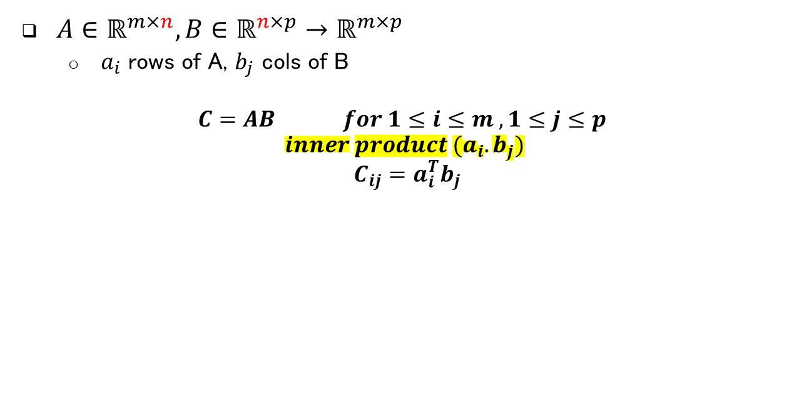
Matrix-Matrix Multiplication
$A∈ℝ^{m×n}, B∈ℝ^{n×p}→ℝ^{m×p}$
$a_{i}$ rows of A, $b_{j}$ cols of B
$$C=AB for 1≤i≤m , 1≤j≤p$$
$$inner product (a_{i}.b_{j})$$
$$C_{ij}=a_{i}^{T}b_{j}$$
Example

Slide 11
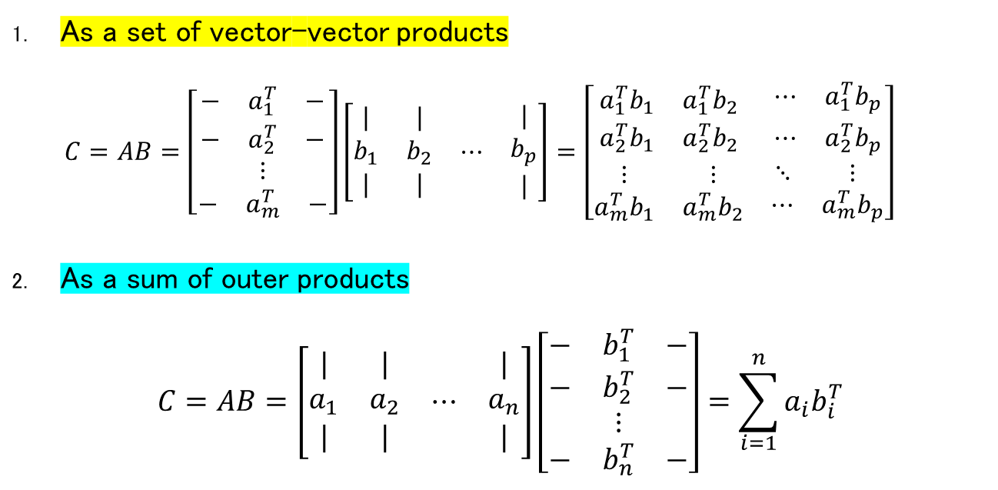
Matrix-Matrix Multiplication (different views)
As a set of vector-vector products
$$C=AB=\left[\begin{matrix}\begin{matrix}\begin{matrix}− & a_{1}^{T} & −\end{matrix} \\ \begin{matrix}− & a_{2}^{T} & −\end{matrix}\end{matrix} \\ \begin{matrix}⋮ \\ \begin{matrix}− & a_{m}^{T} & −\end{matrix}\end{matrix}\end{matrix}\right]\left[\begin{matrix}\begin{matrix}\begin{matrix}| \\ b_{1} \\ |\end{matrix} & \begin{matrix}| \\ b_{2} \\ |\end{matrix}\end{matrix} & \begin{matrix}⋯ & \begin{matrix}| \\ b_{p} \\ |\end{matrix}\end{matrix}\end{matrix}\right]=\left[\begin{matrix}\begin{matrix}a_{1}^{T}b_{1} & a_{1}^{T}b_{2} \\ a_{2}^{T}b_{1} & a_{2}^{T}b_{2}\end{matrix} & \begin{matrix}⋯ & a_{1}^{T}b_{p} \\ ⋯ & a_{2}^{T}b_{p}\end{matrix} \\ \begin{matrix}⋮ & ⋮ \\ a_{m}^{T}b_{1} & a_{m}^{T}b_{2}\end{matrix} & \begin{matrix}⋱ & ⋮ \\ ⋯ & a_{m}^{T}b_{p}\end{matrix}\end{matrix}\right]$$
As a sum of outer products
$$C=AB=\left[\begin{matrix}\begin{matrix}\begin{matrix}| \\ a_{1} \\ |\end{matrix} & \begin{matrix}| \\ a_{2} \\ |\end{matrix}\end{matrix} & \begin{matrix}⋯ & \begin{matrix}| \\ a_{n} \\ |\end{matrix}\end{matrix}\end{matrix}\right]\left[\begin{matrix}\begin{matrix}\begin{matrix}− & b_{1}^{T} & −\end{matrix} \\ \begin{matrix}− & b_{2}^{T} & −\end{matrix}\end{matrix} \\ \begin{matrix}⋮ \\ \begin{matrix}− & b_{n}^{T} & −\end{matrix}\end{matrix}\end{matrix}\right]=\sum_{i=1}^{n}{a_{i}b_{i}^{T}}$$

Slide 12
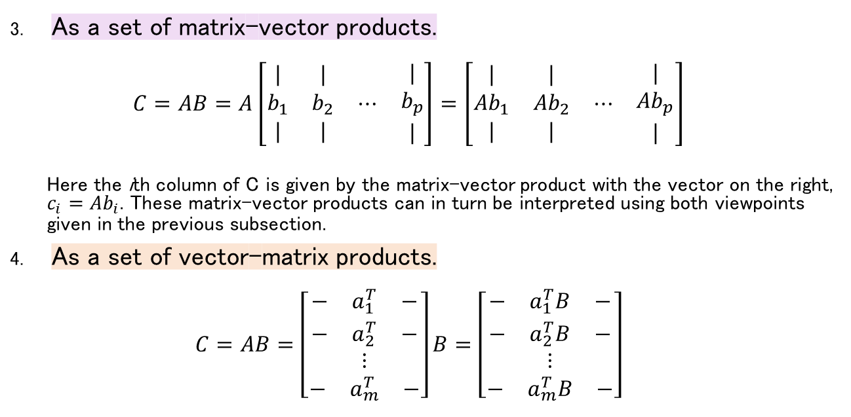
Matrix-Matrix Multiplication (different views)
As a set of matrix-vector products.
$$C=AB=A\left[\begin{matrix}\begin{matrix}\begin{matrix}| \\ b_{1} \\ |\end{matrix} & \begin{matrix}| \\ b_{2} \\ |\end{matrix}\end{matrix} & \begin{matrix}⋯ & \begin{matrix}| \\ b_{p} \\ |\end{matrix}\end{matrix}\end{matrix}\right]=\left[\begin{matrix}\begin{matrix}\begin{matrix}| \\ {Ab}_{1} \\ |\end{matrix} & \begin{matrix}| \\ {Ab}_{2} \\ |\end{matrix}\end{matrix} & \begin{matrix}⋯ & \begin{matrix}| \\ {Ab}_{p} \\ |\end{matrix}\end{matrix}\end{matrix}\right]$$
Here the ith column of C is given by the matrix-vector product with the vector on the right, $c_{i}=Ab_{i}$. These matrix-vector products can in turn be interpreted using both viewpoints given in the previous subsection.
As a set of vector-matrix products.
$$C=AB=\left[\begin{matrix}\begin{matrix}\begin{matrix}− & a_{1}^{T} & −\end{matrix} \\ \begin{matrix}− & a_{2}^{T} & −\end{matrix}\end{matrix} \\ \begin{matrix}⋮ \\ \begin{matrix}− & a_{m}^{T} & −\end{matrix}\end{matrix}\end{matrix}\right]B=\left[\begin{matrix}\begin{matrix}\begin{matrix}− & a_{1}^{T}B & −\end{matrix} \\ \begin{matrix}− & a_{2}^{T}B & −\end{matrix}\end{matrix} \\ \begin{matrix}⋮ \\ \begin{matrix}− & a_{m}^{T}B & −\end{matrix}\end{matrix}\end{matrix}\right]$$

Slide 13
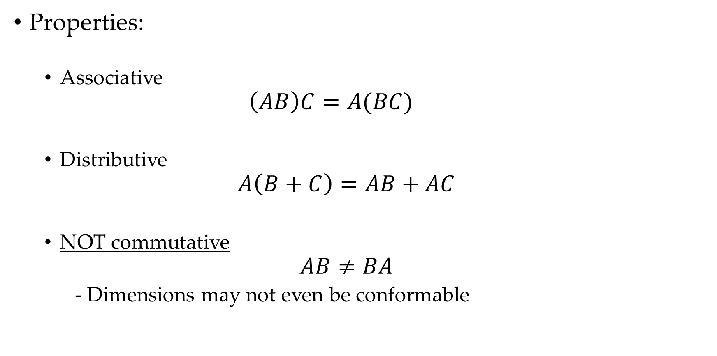
Matrix-Matrix Multiplication
Properties:
Associative
$$\left(AB\right)C=A(BC)$$
Distributive
$$A\left(B+C\right)=AB+AC$$
NOT commutative
$$AB≠BA$$
- Dimensions may not even be conformable

Slide 14
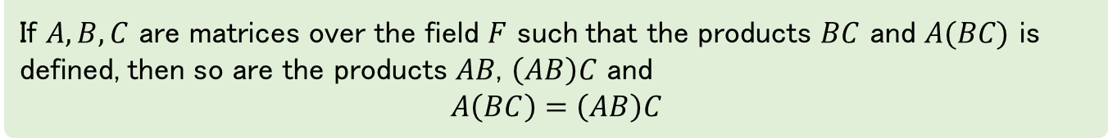
Matrix-Matrix Multiplication
Theorem
If $A,B,C$ are matrices over the field $F$ such that the products $BC$ and $A(BC)$ is defined, then so are the products $AB$, $\left(AB\right)C$ and
$$A\left(BC\right)=\left(AB\right)C$$
Proof:
Note
Linear combinations of linear combinations of the rows of C are again linear combinations of the rows of C
Notes:
کادر پایین نتیجه ای که از اثبات قضیه میگیریم

Slide 15
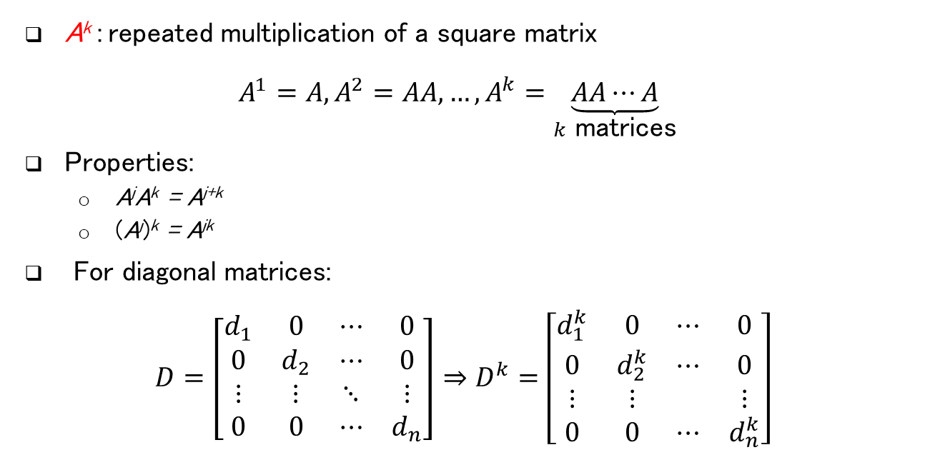
Matrix Power
A^{k} : repeated multiplication of a square matrix
$$A^{1}=A, A^{2}=AA,…, A^{k}=\underset{k \text{matrices}}{\underbrace{AA⋯A}}$$
Properties:
A^{j}A^{k} = A^{j+k}
(A^{j})^{k} = A^{jk}
For diagonal matrices:
$$D=\left[\begin{matrix}d_{1} & 0 & ⋯ & 0 \\ 0 & d_{2} & ⋯ & 0 \\ ⋮ & ⋮ & ⋱ & ⋮ \\ 0 & 0 & ⋯ & d_{n}\end{matrix}\right]⇒D^{k}=\left[\begin{matrix}d_{1}^{k} & 0 & ⋯ & 0 \\ 0 & d_{2}^{k} & ⋯ & 0 \\ ⋮ & ⋮ & & ⋮ \\ 0 & 0 & ⋯ & d_{n}^{k}\end{matrix}\right]$$
where j and k are non-negative integers and A⁰ is assumed to be I
Notes:
خوب از قضیه قبل این رو میشه نتیجه گرفت

Slide 16
Elementary Row Operations

Slide 17
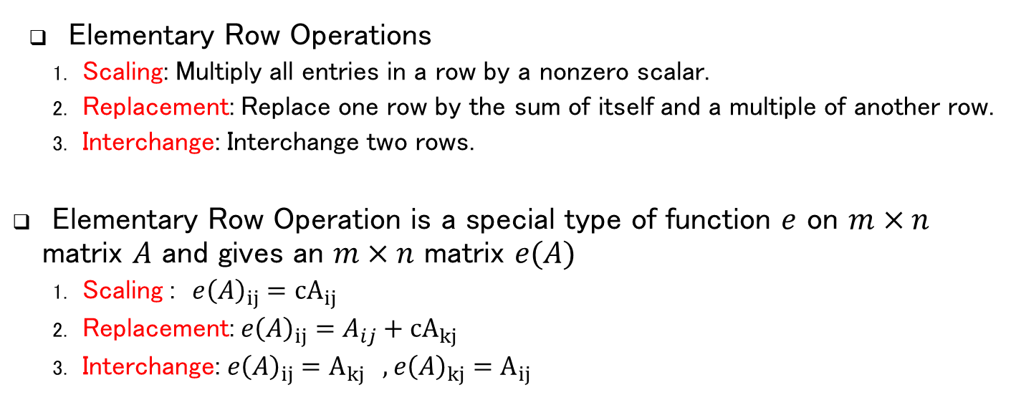
Gaussian Elimination: Elementary Row Operations
Elementary Row Operations
Scaling: Multiply all entries in a row by a nonzero scalar.
Replacement: Replace one row by the sum of itself and a multiple of another row.
Interchange: Interchange two rows.
Elementary Row Operation is a special type of function $e$ on $m×n$ matrix $A$ and gives an $m×n$ matrix $e(A)$
Scaling : $e{\left(A\right)}_{ij}={cA}_{ij}$
Replacement: $e{\left(A\right)}_{ij}={A_{ij}+cA}_{kj}$
Interchange: $e{\left(A\right)}_{ij}=A_{kj} ,e{\left(A\right)}_{kj}=A_{ij}$
In defining $e\left(A\right),$it is not really important how many columns A has, but the number of rows of $A$ is crucial.

Slide 18
Inverse of Elementary Row Operation
Theorem
The inverse operation (function) of an elementary row operation exists and is a elementary row operation of the same type.
Proof:

Slide 19
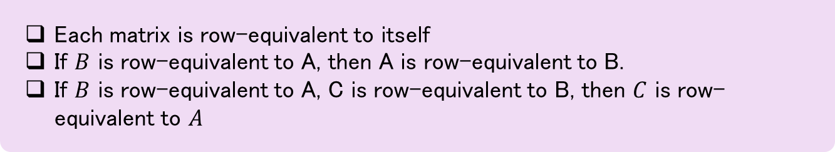
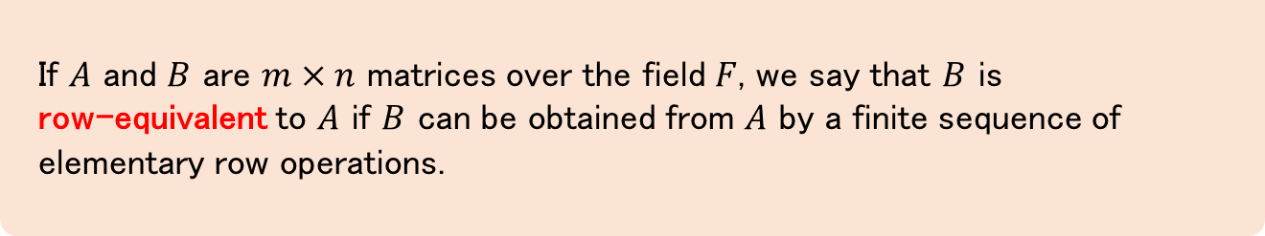
Row-Equivalent
Definition
If $A$ and $B$ are $m×n$ matrices over the field $F$, we say that $B$ is
row-equivalent to $A$ if $B$ can be obtained from $A$ by a finite sequence of elementary row operations.
Note (from pervious theorem and this definition)
Each matrix is row-equivalent to itself
If $B$ is row-equivalent to A, then A is row-equivalent to B.
If $B$ is row-equivalent to A, C is row-equivalent to B, then $C$ is row-equivalent to $A$

Slide 20
Elementary Matrices

Slide 21
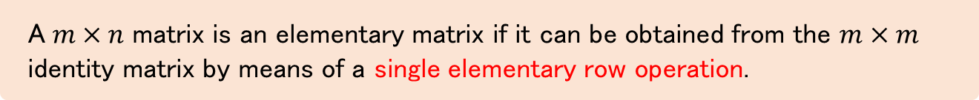
Elementary Matrices
Definition
A$m×n$ matrix is an elementary matrix if it can be obtained from the $m×m$ identity matrix by means of a single elementary row operation.
Example
Find all $2×2$elementary matrices.

Slide 22
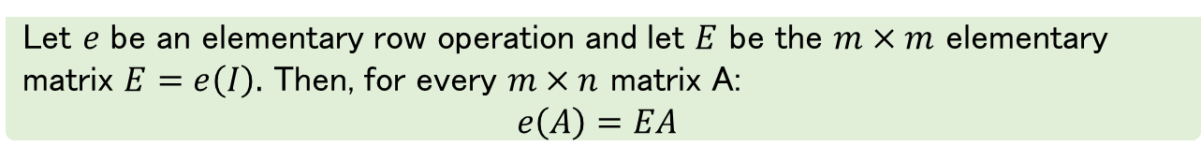
Elementary Matrices and Elementary Row Operation
Theorem
Let $e$ be an elementary row operation and let $E$ be the $m×m$ elementary matrix $E=e\left(I\right).$ Then, for every $m×n$ matrix A:
$e\left(A\right)=EA$
Proof:
Multiplication of a matrix on the left by a square matrix performs row operations.

Slide 23
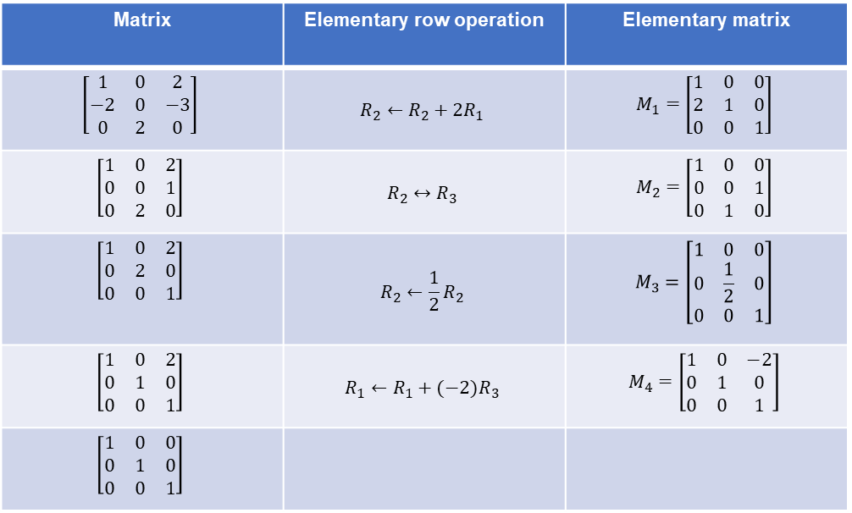

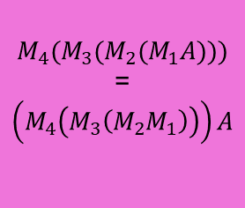
Elementary Matrices
Example
Matrix | Elementary row operation | Elementary matrix
$$\left[\begin{matrix}1 & 0 & 2 \\ −2 & 0 & −3 \\ 0 & 2 & 0\end{matrix}\right]$$ | $$R_{2}←R_{2}+2R_{1}$$ | $$M_{1}=\left[\begin{matrix}1 & 0 & 0 \\ 2 & 1 & 0 \\ 0 & 0 & 1\end{matrix}\right]$$
$$\left[\begin{matrix}1 & 0 & 2 \\ 0 & 0 & 1 \\ 0 & 2 & 0\end{matrix}\right]$$ | $$R_{2}↔R_{3}$$ | $$M_{2}=\left[\begin{matrix}1 & 0 & 0 \\ 0 & 0 & 1 \\ 0 & 1 & 0\end{matrix}\right]$$
$$\left[\begin{matrix}1 & 0 & 2 \\ 0 & 2 & 0 \\ 0 & 0 & 1\end{matrix}\right]$$ | $$R_{2}←\frac{1}{2}R_{2}$$ | $$M_{3}=\left[\begin{matrix}1 & 0 & 0 \\ 0 & \frac{1}{2} & 0 \\ 0 & 0 & 1\end{matrix}\right]$$
$$\left[\begin{matrix}1 & 0 & 2 \\ 0 & 1 & 0 \\ 0 & 0 & 1\end{matrix}\right]$$ | $$R_{1}←R_{1}+(−2)R_{3}$$ | $$M_{4}=\left[\begin{matrix}1 & 0 & −2 \\ 0 & 1 & 0 \\ 0 & 0 & 1\end{matrix}\right]$$
$$\left[\begin{matrix}1 & 0 & 0 \\ 0 & 1 & 0 \\ 0 & 0 & 1\end{matrix}\right]$$
(From theorem)
$${M_{4}(M_{3}(M}_{2}(M_{1}A)))$$
=
$$\left(M_{4}\left(M_{3}\left(M_{2}M_{1}\right)\right)\right)A$$

Slide 24
Row-Equivalent and Elementary Matrices
Theorem
Let A and B be $m×n$ matrices over the field $F.$ Then $B$ is row-equivalent to $A$ if and only if $B=PA$, where $P$is a product of $m×m$ elementary matrices.

Slide 25
Linear Equations

Slide 26
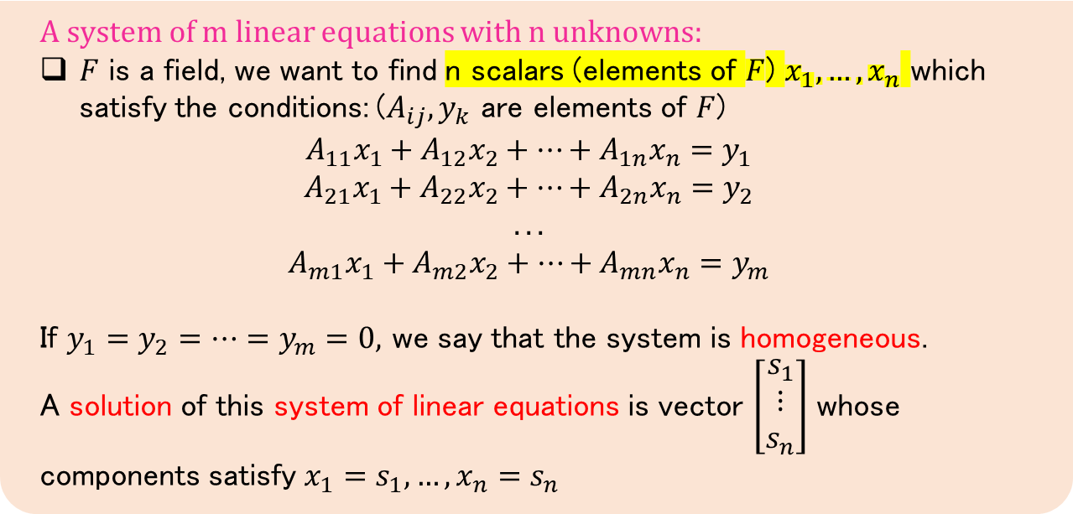
Systems of Linear Equations
Definition
A system of m linear equations with n unknowns:
$F$ is a field, we want to find n scalars (elements of $F$) $x_{1},…,x_{n}$ which satisfy the conditions: ($A_{ij},y_{k}$ are elements of $F$)
$$A_{11}x_{1}+A_{12}x_{2}+…+A_{1n}x_{n}=y_{1}$$
$$A_{21}x_{1}+A_{22}x_{2}+…+A_{2n}x_{n}=y_{2}$$
$$...$$
$$A_{m1}x_{1}+A_{m2}x_{2}+…+A_{mn}x_{n}=y_{m}$$
If $y_{1}=y_{2}=…=y_{m}=0,$ we say that the system is homogeneous.
A solution of this system of linear equations is vector $\left[\begin{matrix}s_{1} \\ ⋮ \\ s_{n}\end{matrix}\right]$ whose components satisfy $x_{1}=s_{1}, …, x_{n}=s_{n}$

Slide 27
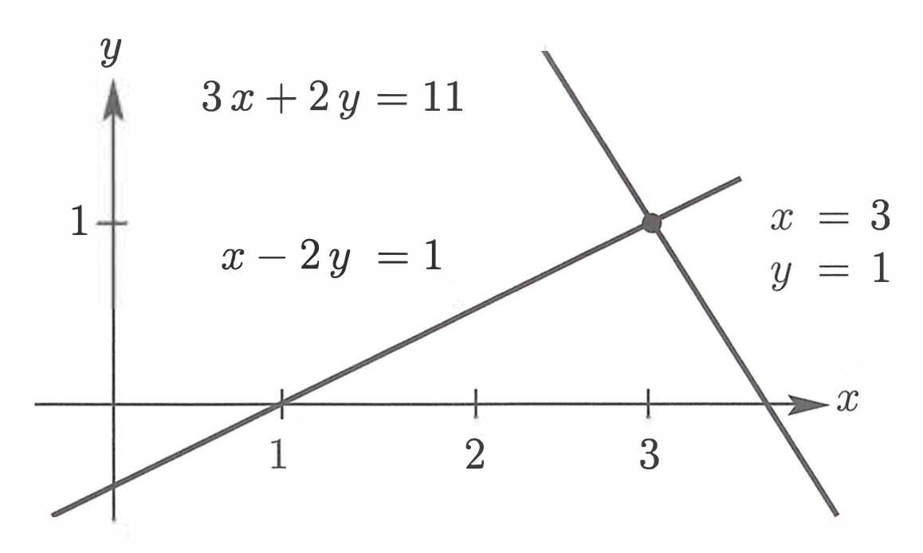
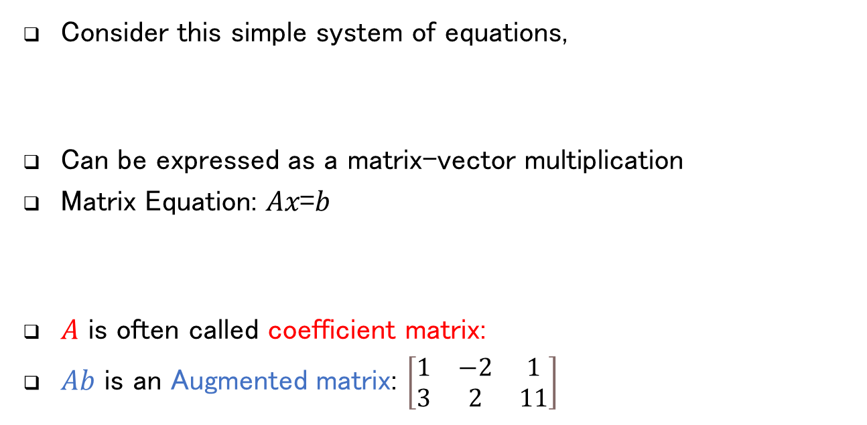

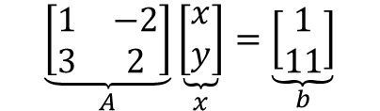

Linear Equation (Geometric Interpretation and Intuition)
Consider this simple system of equations,
Can be expressed as a matrix-vector multiplication
Matrix Equation: 𝐴𝑥=𝑏
𝐴 is often called coefficient matrix:
$Ab$ is an Augmented matrix: $\left[\begin{matrix}1 & −2 & 1 \\ 3 & 2 & 11\end{matrix}\right]$
$$x−y=1 \\ 3x+2y=11$$
$$\underset{A}{\underbrace{\left[\begin{matrix}1 & −2 \\ 3 & 2\end{matrix}\right]}}\underset{x}{\underbrace{\left[\begin{aligned}x \\ y\end{aligned}\right]}}=\underset{b}{\underbrace{\left[\begin{aligned}1 \\ 11\end{aligned}\right]}}$$
$$\left[\begin{matrix}1 & −2 \\ 3 & 2\end{matrix}\right]$$

Slide 28
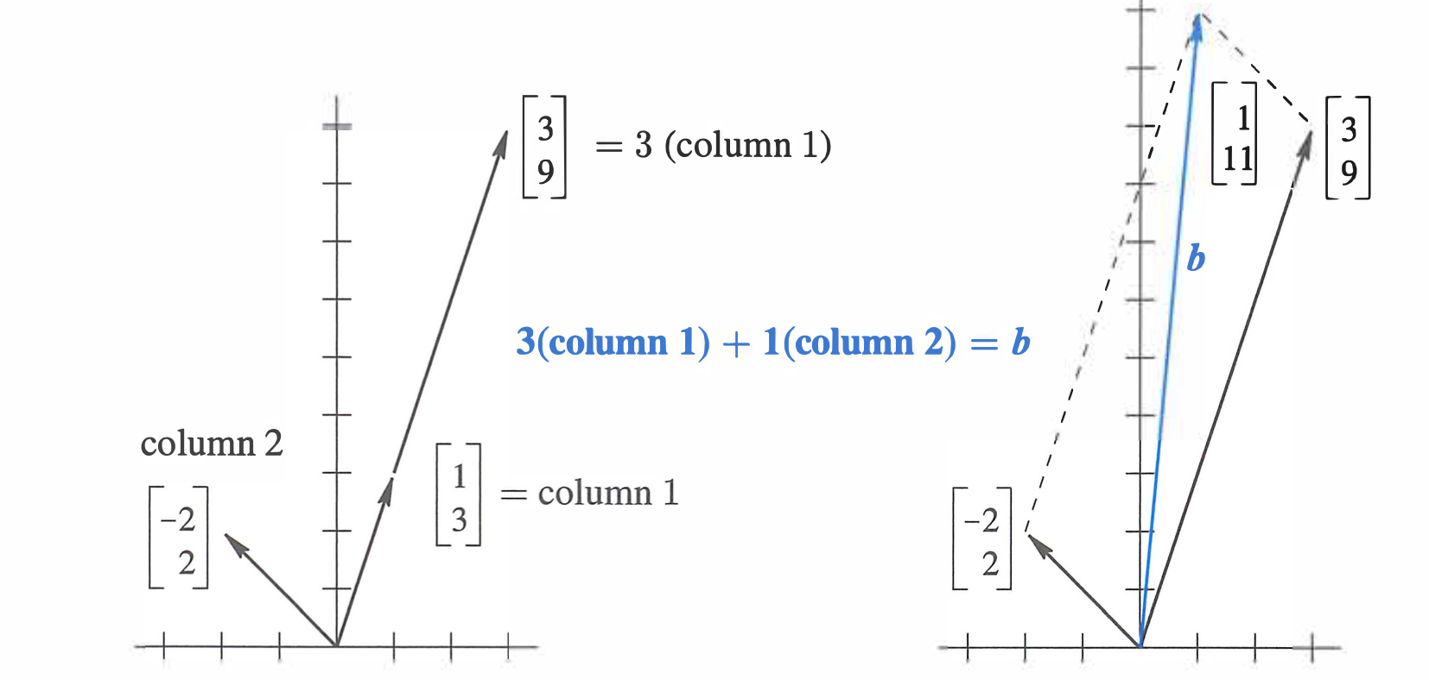

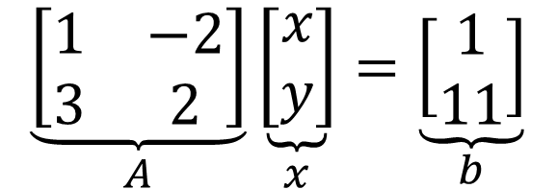
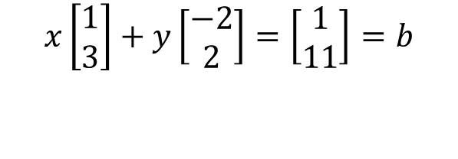
Vectors & Linear Equation
Also, Can be expressed as linear combination of cols:
$$x −2y=1$$
$$3x+2y=11$$
$$\underset{A}{\underbrace{\left[\begin{matrix}1 & −2 \\ 3 & 2\end{matrix}\right]}}\underset{x}{\underbrace{\left[\begin{aligned}x \\ y\end{aligned}\right]}}=\underset{b}{\underbrace{\left[\begin{aligned}1 \\ 11\end{aligned}\right]}}$$
$$x\left[\begin{aligned}1 \\ 3\end{aligned}\right]+y\left[\begin{aligned}−2 \\ 2\end{aligned}\right]=\left[\begin{aligned}1 \\ 11\end{aligned}\right]=b$$
Same for $n$ equation, $n$ variable

Slide 29
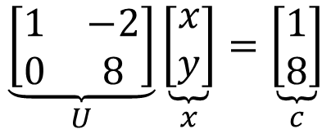
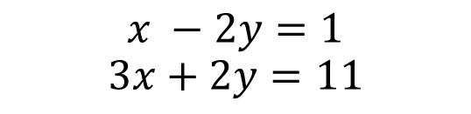
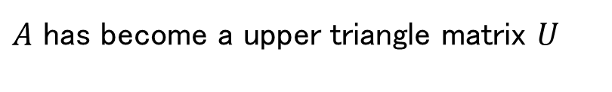
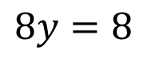
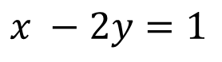
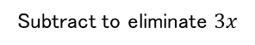
Idea Of Elimination
Subtract a multiple of equation $(1)$ from $(2)$ to eliminate a variable
$$x −2y=1$$
$$3x+2y=11$$
multiply equation 1 by 3
$$x −2y=1$$
Subtract to eliminate $3x$
$$8y=8$$
$$\underset{U}{\underbrace{\left[\begin{matrix}1 & −2 \\ 0 & 8\end{matrix}\right]}}\underset{x}{\underbrace{\left[\begin{aligned}x \\ y\end{aligned}\right]}}=\underset{c}{\underbrace{\left[\begin{aligned}1 \\ 8\end{aligned}\right]}}$$
$A$ has become a upper triangle matrix $U$

Slide 30

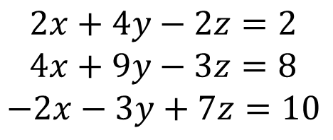

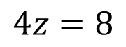
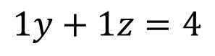
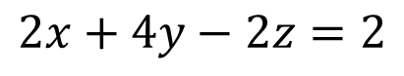

Idea Of Elimination (Row Reduction Algorithm)
The pivots are on the diagonal of the triangle after elimination (boldface 2 below is the first pivot)
$$2x+4y−2z=2 \\ 4x+9y−3z=8 \\ −2x−3y+7z=10$$
$$2x+4y−2z=2$$
$$1y+1z=4$$
$$4z=8$$
Step 1: subtract $(1)$ from $\left(2\right)$ to eliminate x’s in $(2)$
Step 2: subtract $(1)$ from $(3)$ to totally eliminate x
Step 3: subtract new $(2)$ from new $\left(3\right)$
Definition
The variables corresponding to pivot columns in the matrix are called basic variables.
The other variables are called a free variable.
$$\left[\begin{matrix}x & x & x & x \\ 0 & x & x & x \\ 0 & 0 & 0 & x \\ 0 & 0 & 0 & x\end{matrix}\right]$$
$$\left[\begin{matrix}x & x & x & x \\ 0 & x & x & x \\ 0 & 0 & x & x \\ 0 & 0 & 0 & x\end{matrix}\right]$$
Notes:
Pivot:محور

Slide 31
Homogenous system
Theorem
If $A$ and $B$ are row-equivalent $m×n$ matrices, the homogenous systems of linear equations $Ax=0$ and B$x=0$ have exactly the same solutions.
Proof:

Slide 32
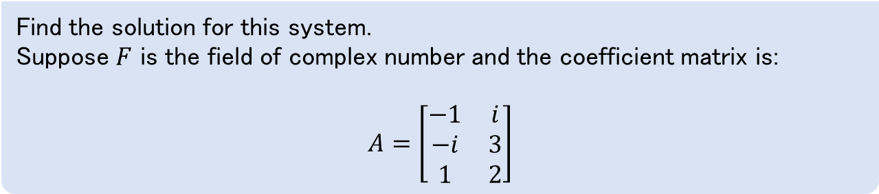
Homogenous system
Example
Find the solution for this system.
Suppose $F$ is the field of complex number and the coefficient matrix is:
$$A=\left[\begin{matrix}−1 & i \\ −i & 3 \\ 1 & 2\end{matrix}\right]$$

Slide 33
Solution of system of linear equations
Definition
The two systems of linear equations are equivalent if each equation in each system is a linear combination of the equations in other system.
Theorem
Equivalent systems of linear equations have exactly the same solutions.
Proof:
Note
It is important to note that row operations are reversible. If two rows are interchanged, they can be returned to their original positions by another interchange.
If the augmented matrices of two linear systems are row equivalent, then the two systems have the same solution set.

Slide 34
Existence and Uniqueness Questions
A system of linear equations has:
No solution
Exactly one solution
Infinitely many solutions
inconsistent
consistent
Next session:
Is the system consistent? That is, does at least one solution exist?
If a solution exists, is it the only one? That is, is the solution unique?

Slide 35




Conclusion
Different view of matrix multiplication
Linear combination and matrix multiplication
Associativity of three matrices multiplication
Gaussian Elimination
Row-equivalent of two matrices
Elementary matrices
System of linear equations
Equivalent systems of linear equations have exactly the same solutions.

Slide 36
References
Chapter 1: Kenneth Hoffman and Ray A. Kunze. Linear Algebra. PHI Learning, 2004.
Chapter 1: David C. Lay, Steven R. Lay, and Judi J. McDonald. Linear Algebra and Its Applications. Pearson, 2016
Chapter 2: David Poole, Linear Algebra: A Modern Introduction. Cengage Learning, 2014.
Chaper1: Gilbert Strang. Introduction to Linear Algebra. Wellesley-Cambridge Press, 2016

Slide 37
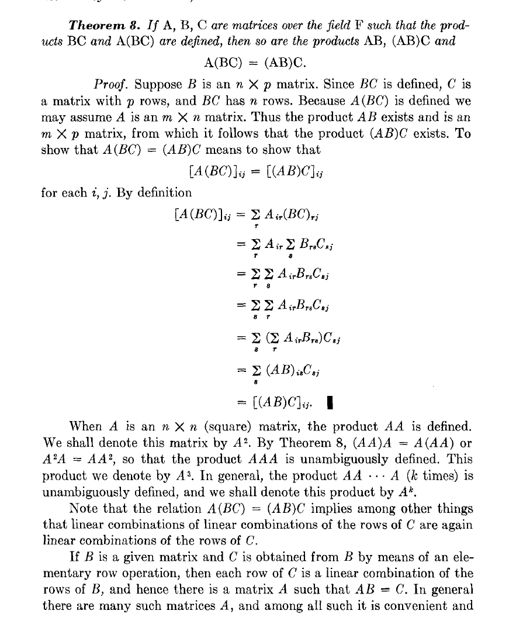
Matrix-Matrix
Multiplication
Theorem

Slide 38
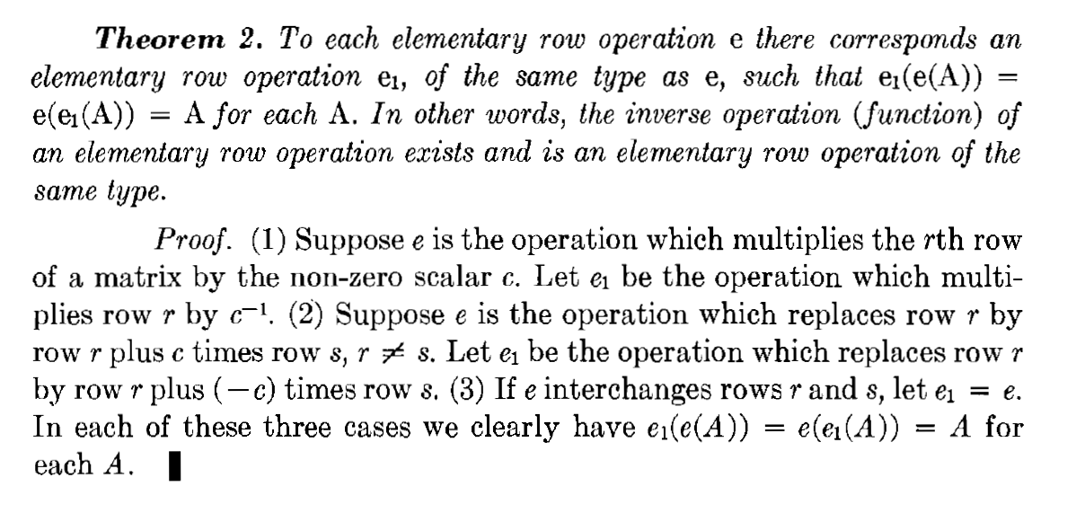
Inverse of Elementary Row Operation

Slide 39
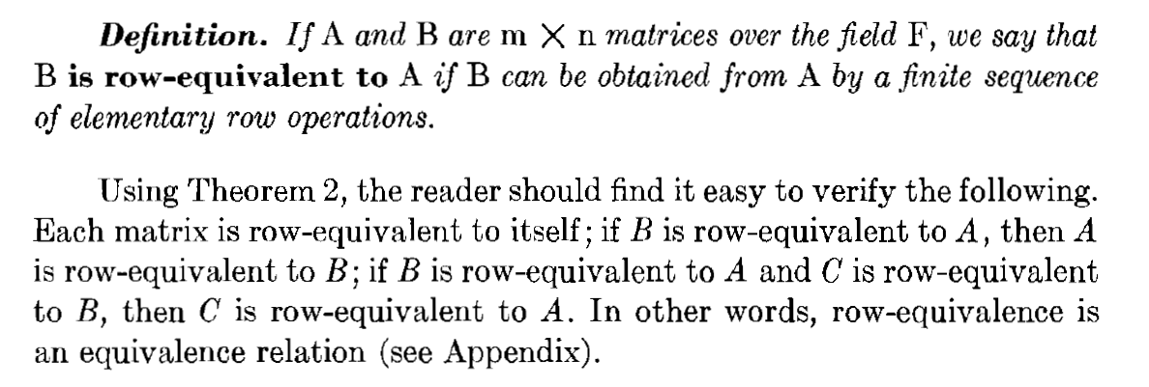
Matrix Matrix multiplication Note (from pervious theorem and this definition)

Slide 40
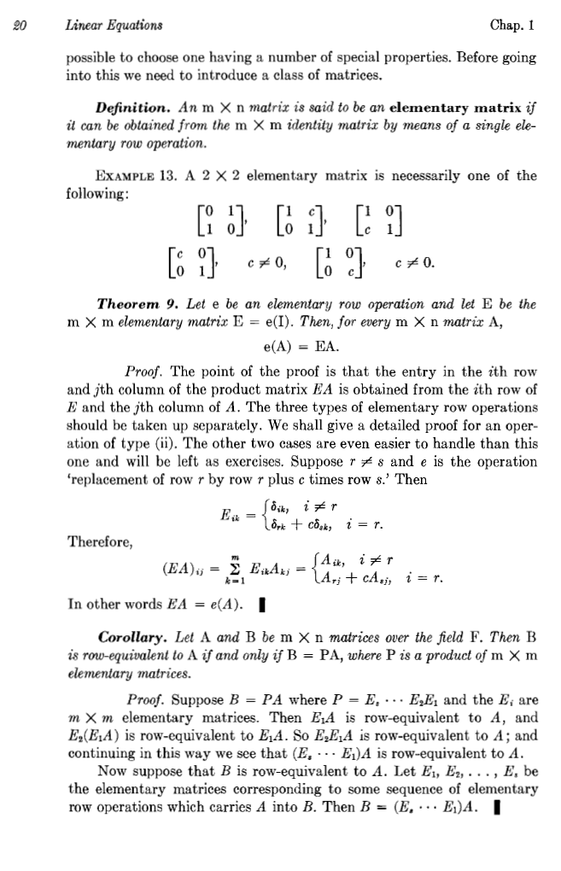
Elementary matrices

Slide 41
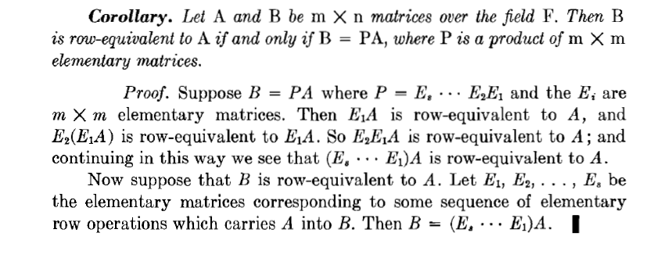
Row-Equivalent and Elementary Matrices
Theorem
Let A and B be $m×n$ matrices over the field $F.$ Then $B$ is row-equivalent to $A$ if and only if $B=PA$, where $P$is a product of $m×m$ elementary matrices.

Slide 42
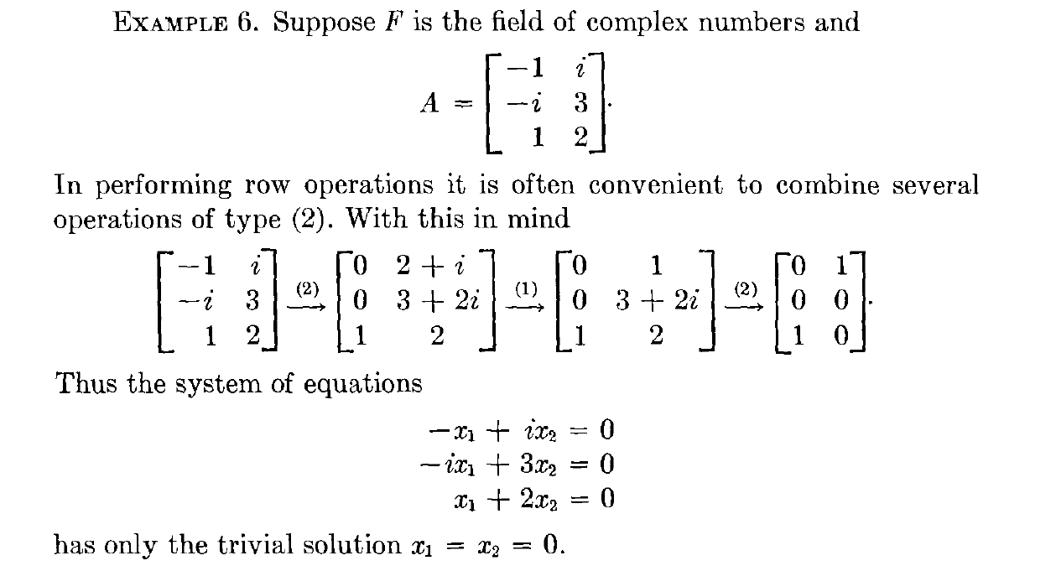
Homogenous system Example

Slide 43
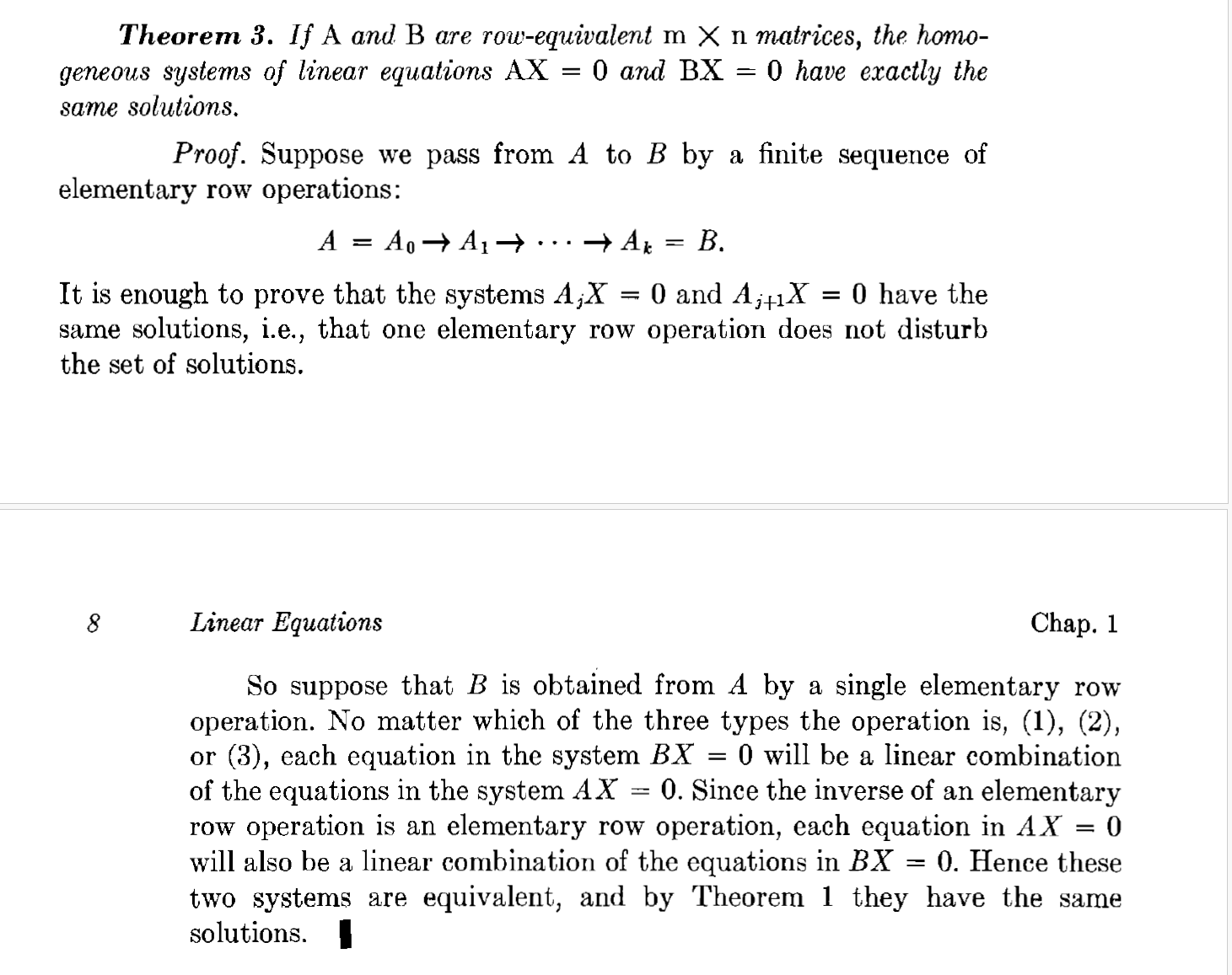
Equivalent systems of linear equations have exactly the same solutions.

